Slide 1
Team 3 – Final Project Presentation
Spotify Tracks Analysis
Alex Khater
Pooja Chandrashekara
Vaishnavi Nagarajaiah
Aditya Nayak

Slide 2

We all listen to music a lot, right? Why do you believe a song becomes popular?

Slide 3
SMART Questions?
S: This question is tied to 3 specific columns in the dataset and a clear response variable, it is quite a specific question.
M: Our response variable is clearly numeric and shows how many times a song is streamed. It is easily measurable.
A: This question is quite attainable with relatively basic modelling and regression methods as all variables are pretty standard integer or categorical data.
R: This question will attempt to refine a popular song down to its core components from a music theory standpoint and give insight into creating one.
T: This project will be easily doable with a team of 4 as the dataset is quite clean from the start and the team is big enough to finish the project quickly

Slide 4
Problem Statement
Identifying music trends and characteristics over the past one hundred years.
Analyze Spotify Raw Data containing 114k+ tracks and 11 audio features extracted from Kaggle
Research on data holding information on release by year and provides numerical ratings for different characteristics of music released.
We want to look into the link between classic music theory metrics (Key, Tempo, Time Signature, Duration, Tempo, Energy, Explicit, Mode) and a song's Spotify streaming popularity to see which elements contribute the most to a song's success.

Slide 5
Dataset Description
This is a spotify dataset, which has songs from over 1000 artists and covers about 125 different genres. This dataset was created using Spotify API.
114K observations and 21 columns.
The popularity column is of type ‘int’ and has a range 0 to 100.
Our dataset is clean and all variables are standard integer or categorical data.
Since there were no NA values, no observations were dropped.
Loudness is measured in Db (-60 to 0db)
Models used:
i) KNN
ii) XGBoost
iii) Polynomial Regression
iv) Linear Regression

Slide 6
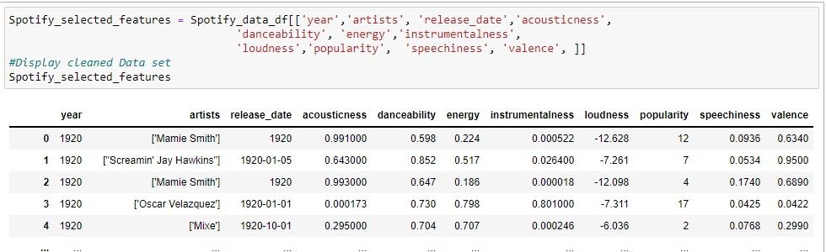
Data Cleanup & Exploration
Our Data frame did not have any Null values.
No data type conversion was needed.

Slide 7
EXPLORATORY DATA ANALYSIS

Slide 8
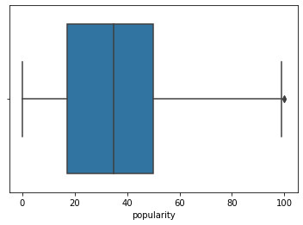
Univariate Analysis of Popularity
Box plot of popularity of tracks

Slide 9
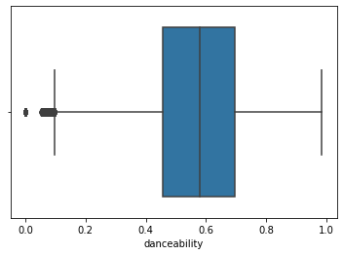
Univariate Analysis of Danceability
Box plot of danceability of tracks

Slide 10
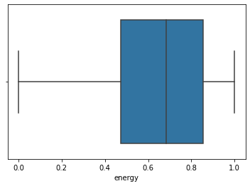
Univariate Analysis of Energy
Box plot of energy of tracks

Slide 11
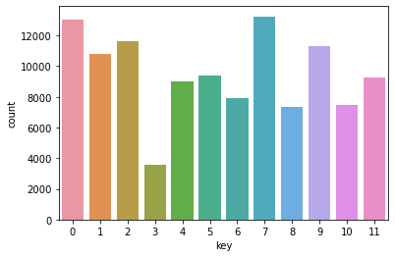
Univariate Analysis of Key
Count plot of key of tracks

Slide 12
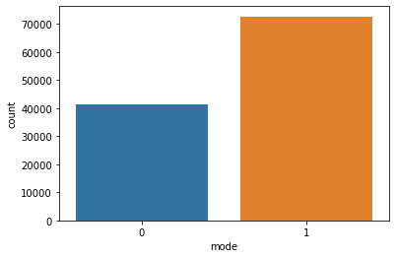
Univariate Analysis of Mode
Count plot of mode of tracks

Slide 13
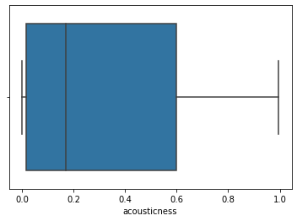
Univariate Analysis of Acousticness
Box plot of acousticness of tracks

Slide 14
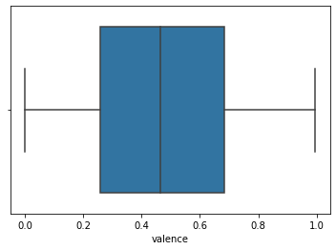
Univariate Analysis of Valence
Box plot of valence of tracks

Slide 15
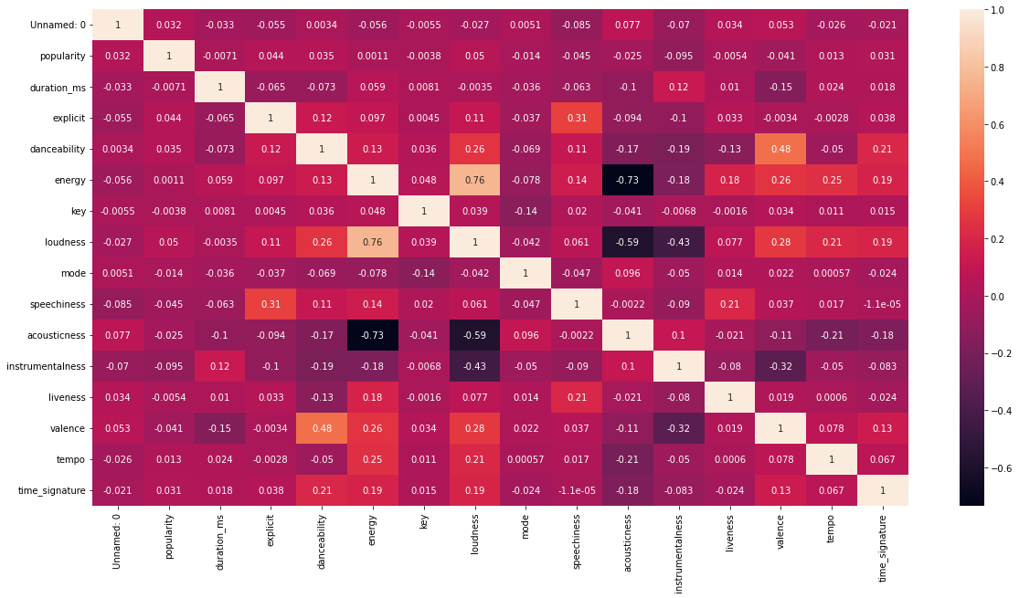
Bi-Variate Analysis

Slide 16
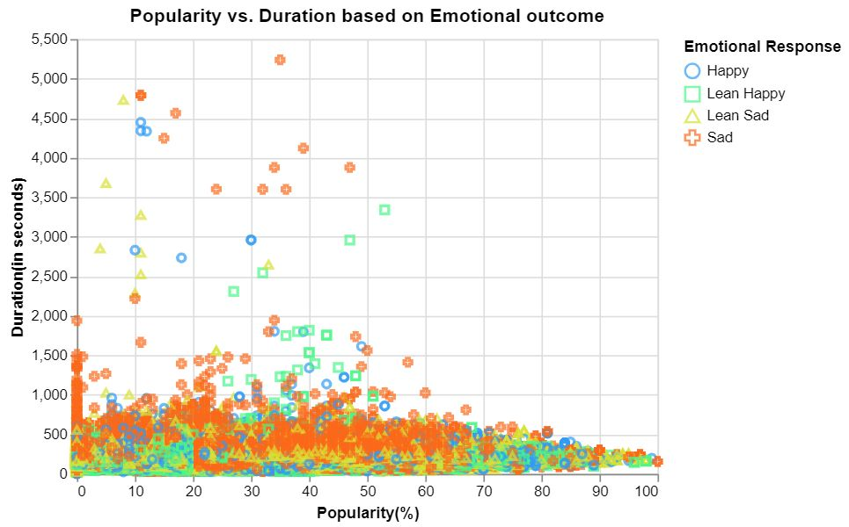
Multivariate Analysis
Popularity vs duration in minutes based on the emotional outcome of the tracks.
We can see low popularity and low danceable songs are seemed to be sad.

Slide 17
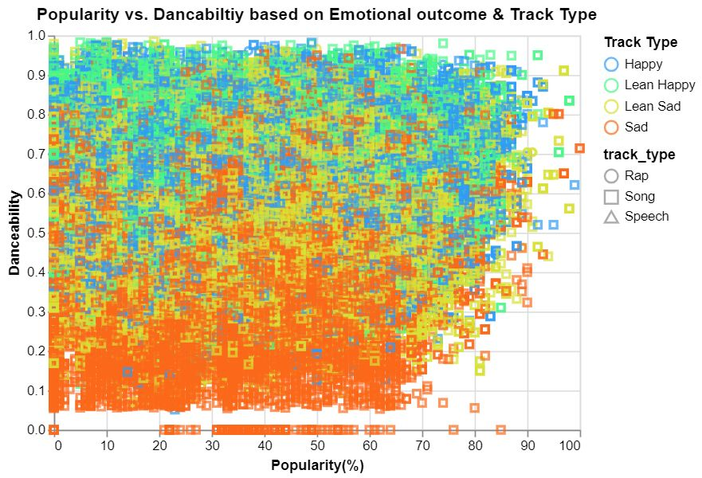
Popularity vs duration in minutes based on the emotional outcome of the tracks and genre.
We can see low popularity and low danceable songs are seemed to be sad and have a low speech track type in them.

Slide 18
Conclusions drawn from EDA
Majority of songs in the dataset seems to be unpopular.
All genres in the dataset are equally divided.
Majority of songs are danceable.
Majority of songs have high energy.
Majority of songs have key 7 i.e, G pitch and 0 i.e, C pitch.
Majority of songs have major modality in track.
Around 110389 tracks are most likely to represent music and other non-speech like music.
Majority of tracks have low acousticness.
Average of tracks are likely to sound more negative.

Slide 19
Modeling Task 1: Modeling Popularity
Two Main Questions:
Is there a “magic” song that our model can find that will be popular ?
Are Spotify’s metrics for describing music better at predicting a song’s popularity than traditional metrics ?

Slide 20
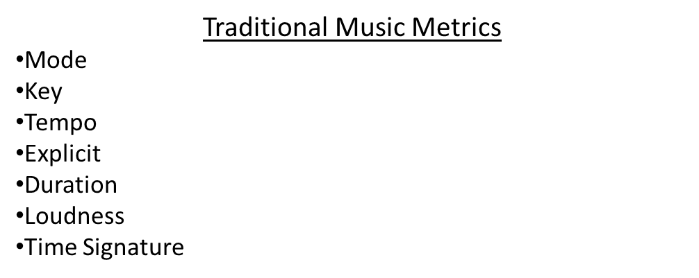
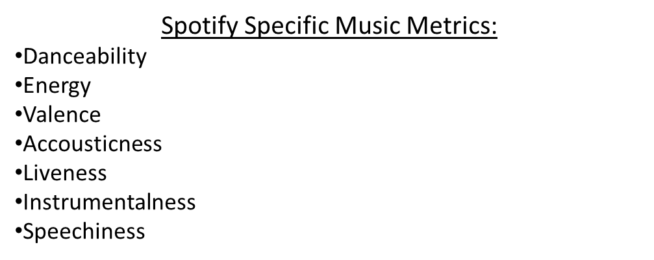
Modeling Task 1: Modeling Popularity
Split The Variables into Two Categories:

Slide 21
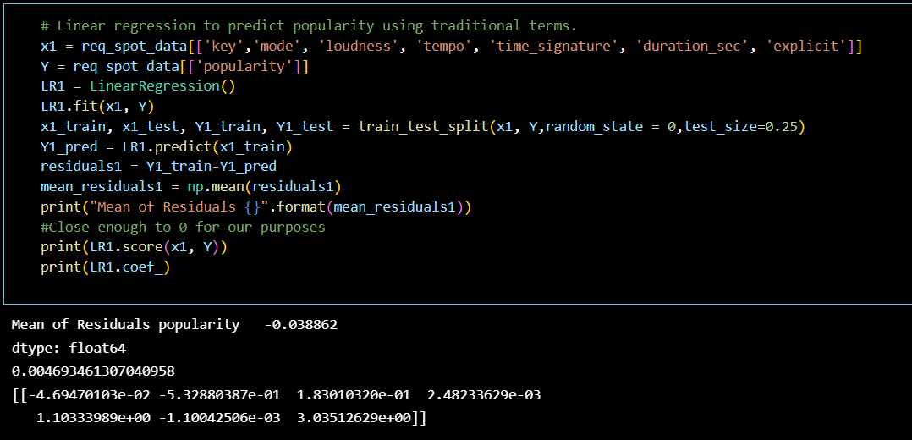
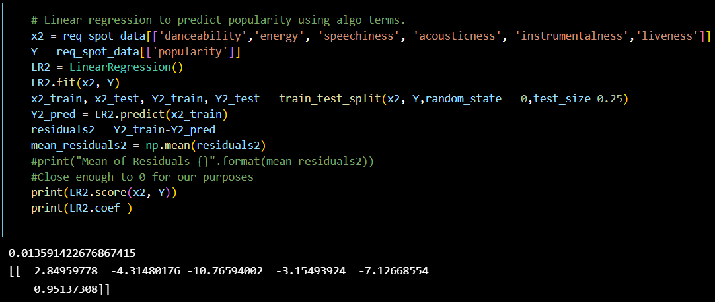
Comparison 1.a : Multiple Linear Regression
Traditional Metric Model
Spotify Metric Model
R^2= 0.00459
R^2= 0.01359
Conclusions:
The R-squared is not good on either model, it seems there is no “magic song” yet.
The algorithmic metrics do seem to be better (though still NOT GOOD).
Maybe the data isn’t suited for linear regression.

Slide 22
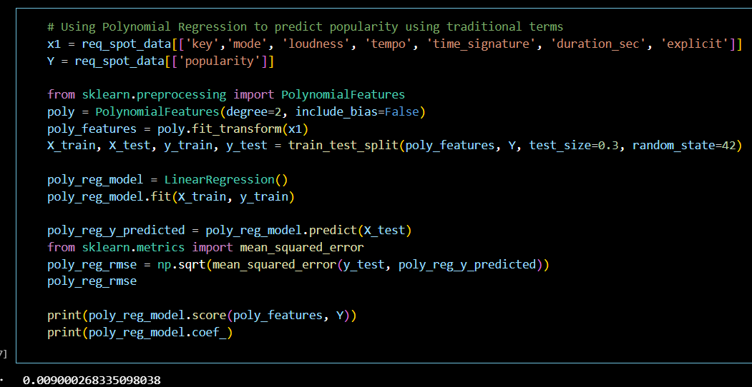
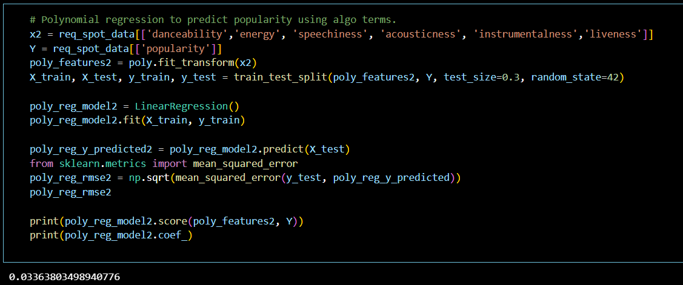
Comparison 1.b : Polynomial Regression
Traditional Metric Model
Spotify Metric Model
R^2= 0.0090
R^2= 0.0336
Conclusion
The R-squared is still not good on either model, but it is MUCH better.
The algorithmic metrics do seem to be much better yet again.

Slide 23
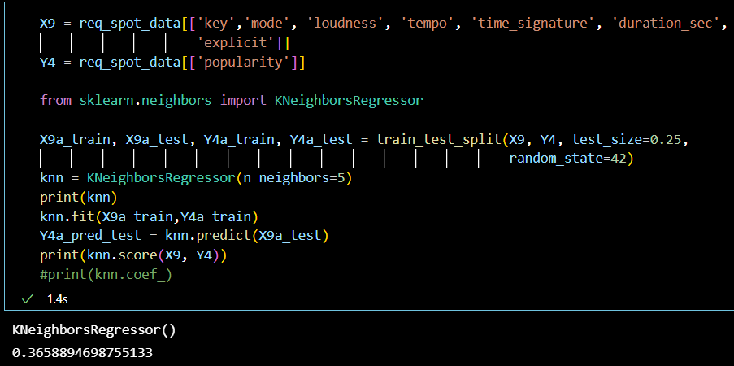
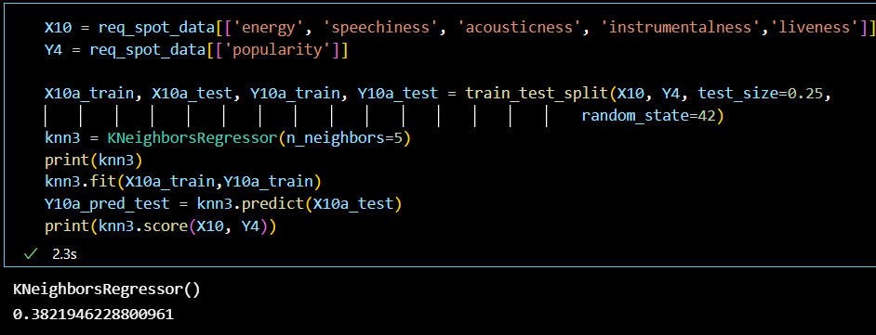
Comparison 1.c : KNN Regression
Traditional Metric Model
Spotify Metric Model
R^2= 0.365
R^2= 0.3821
Conclusions:
The R-squared is much better and is mediocre for regression
The algorithmic metrics do seem to be much better yet again, but the gap has closed

Slide 24
Modelling Task 2: Modeling Danceability

Slide 25
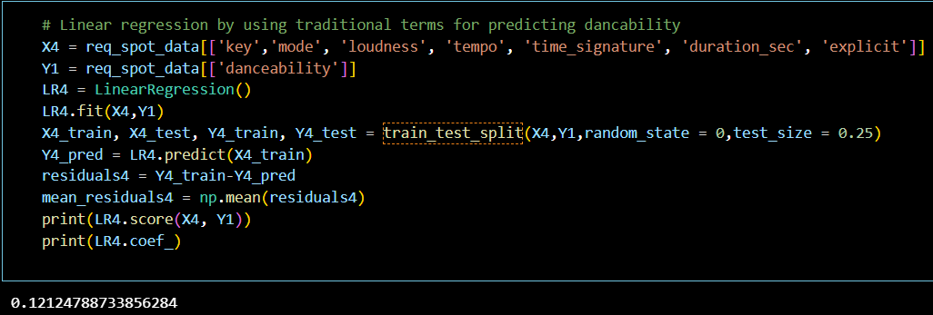
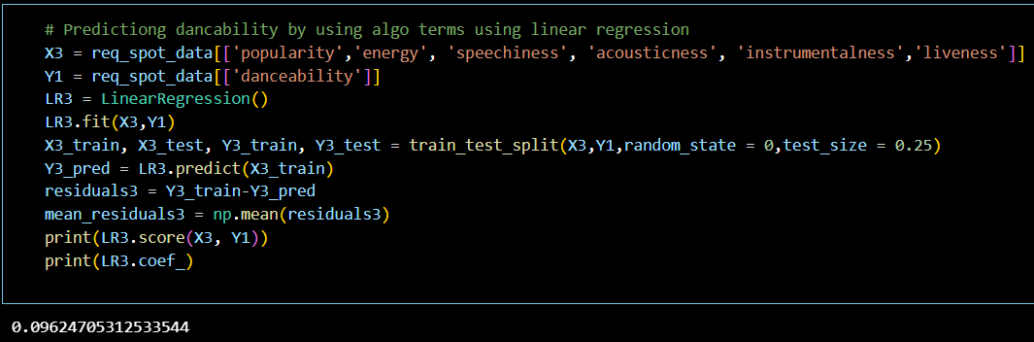
Comparison 2.a : Multiple Linear Regression
R^2 = 0.121
R^2 = 0.096
Conclusion:
The Root Mean Squared Error(RMSE) is somewhat better than the the Multi Linear Regression model of predicting popularity.
The traditional metrics here also do not contribute much compared to the algorithmic variables.
However, the accuracy is not enough to use this as a predicting model.

Slide 26
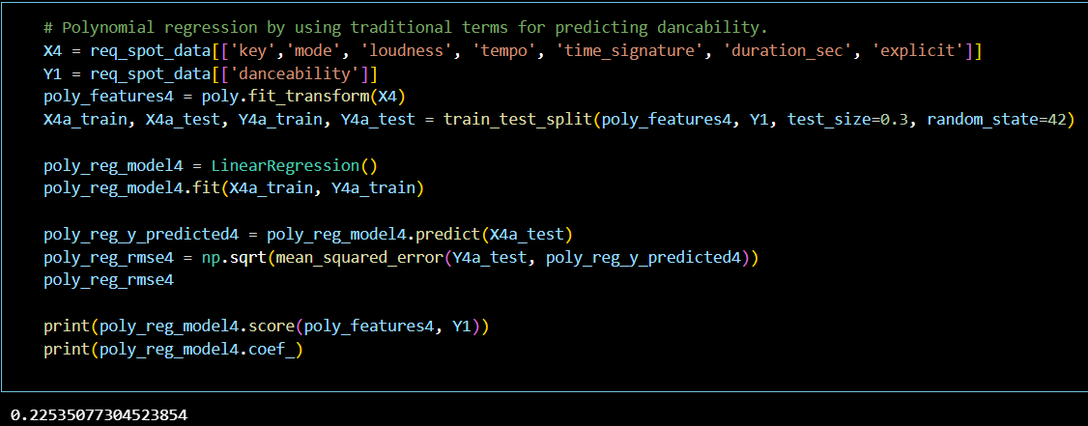
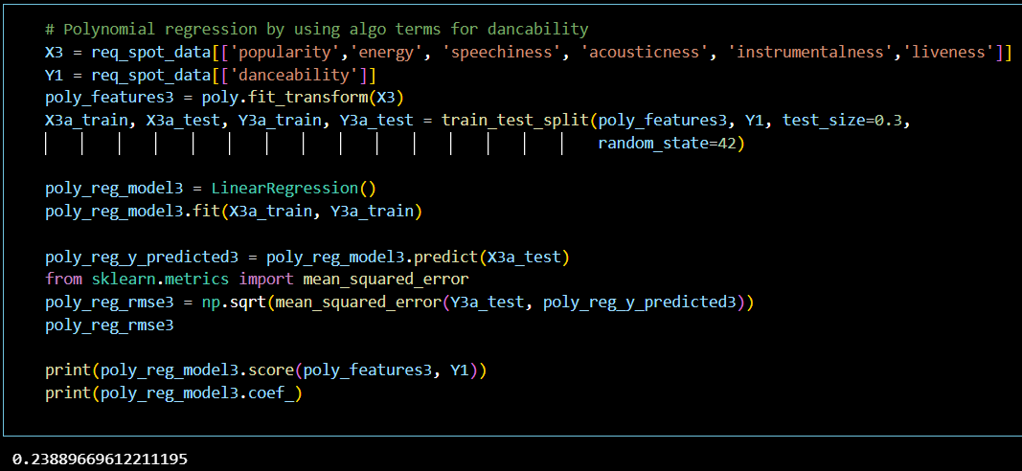
Comparison 2.b : Polynomial Regression
R^2 = 0.225
R^2 = 0.239
Conclusion:
The Polynomial Regression model gives a slightly better accuracy.
Also the RMSE of the model having algorithmic terms give a better accuracy.
Model not suitable for prediction.

Slide 27
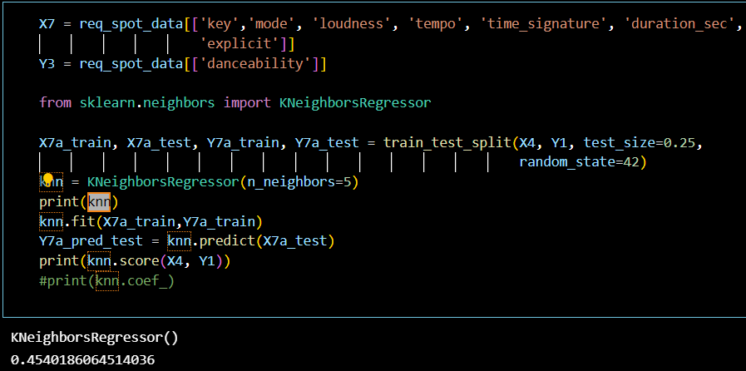
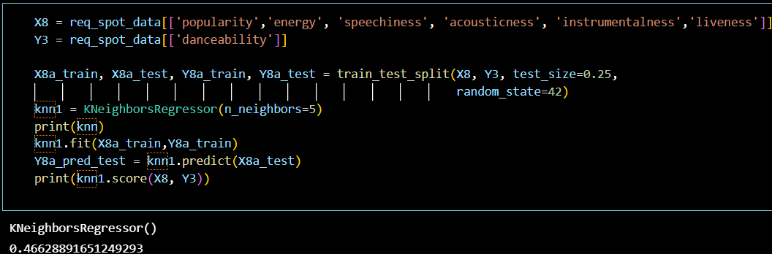
Comparison 2.c : KNN Regression
R^2 = 0.454
R^2 = 0.466
Conclusion:
The KNN Regression model gives a better accuracy.
Algorithmic variables help predicting better than traditional variables.
Model could be used for predicting.

Slide 28
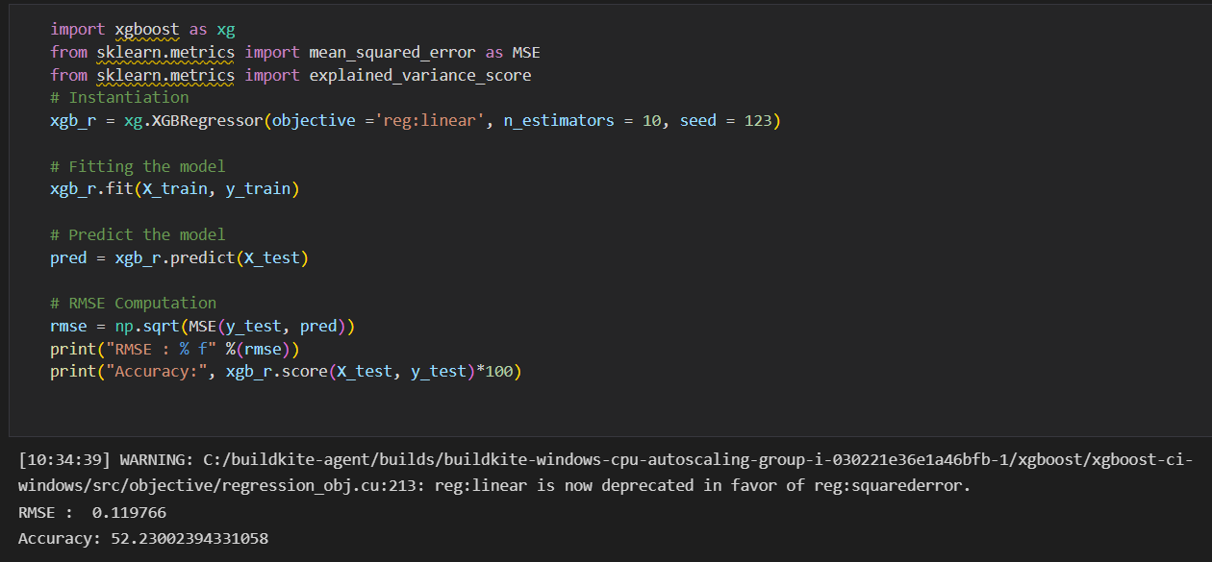
Comparison 2.d : XGBOOST Regression
Conclusion:
The XGBoost Regression model gives better accuracy of around 52%.
Algorithmic variables combined with traditional variables help predict better than algorithmic variables alone.
Notes:
Combining traditional and algorithmic model -> algorithmic model gives best results but with the help of traditional model it can give better results.

Slide 29
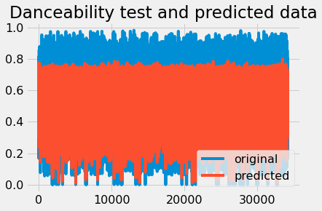
Danceability test plot
We can see that only half of the predicted value is overlapping with the original value. So it justifies the 52% accuracy we got in the model.
Notes:
We can see that only half of predicted value is overlapping with original value. So it justifies the 52% accuracy we got

Slide 30
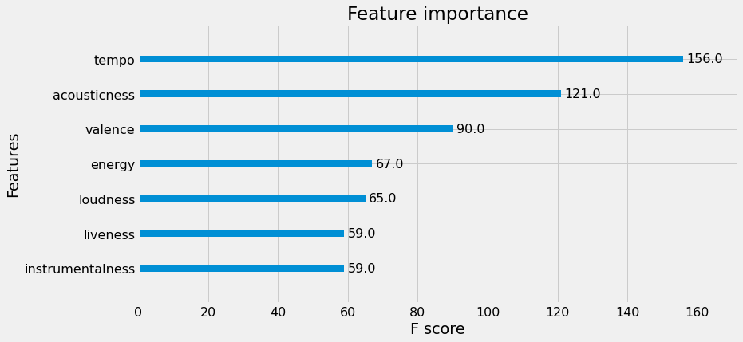
Feature importance selected by XGBoost Model
Even though in the correlation matrix tempo is not related to danceability, we can see tempo is given the highest importance in the XGBoost model.
Notes:
Even though in the correlation matrix tempo is not related to danceability, we can see tempo is given highest importance in the XGBoost model.

Slide 31
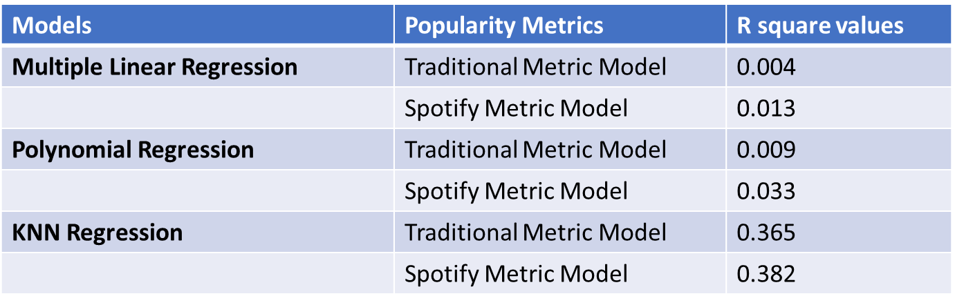
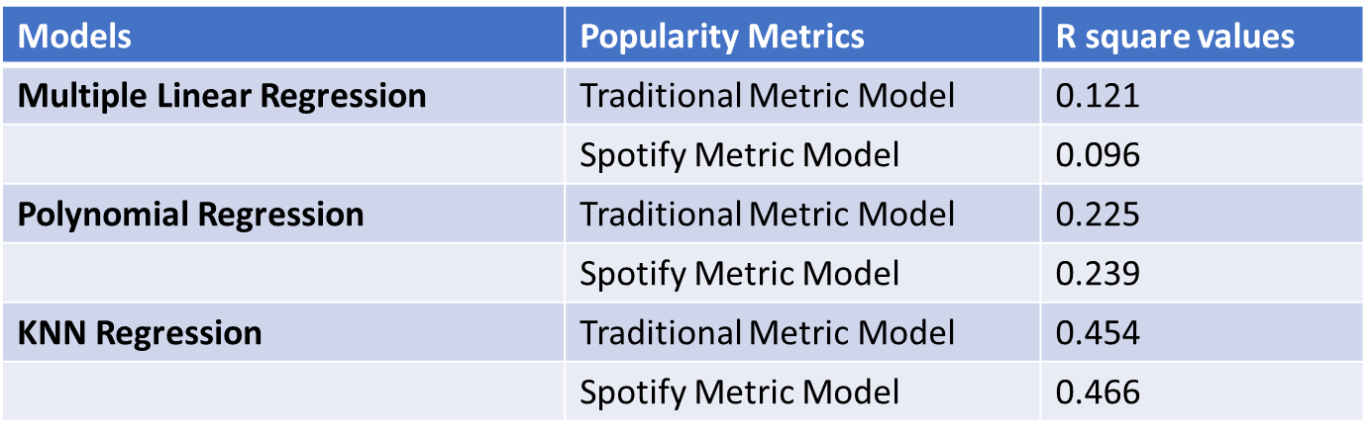
Model Evaluation Results
Popularity Metric Model Danceability Metric Model

Slide 32
Conclusion
After the EDA analysis, while attempting to determine what factors influence the popularity of songs in the dataset, we came across the fact that popularity doesn’t have a correlation with any of the variables in the dataset.
This led us to believe that Spotify does not utilize a traditional approach to its dataset, but rather an automated method.
After performing modeling on popularity metric we found that, what makes a song popular is not inherent in the song itself and Spotify has developed more useful methods for describing music in the age of streaming.
When we considered the danceability metric we observed that, the traditional metrics here also do not contribute much compared to the algorithmic variables with all the models.
We used the XGBoost model for both the metrics and observed that combining traditional and algorithmic models. The algorithmic model gives the best results but with the help of the traditional model.
As a result, we chose danceability as our goal variable due to its high connection with other factors such as valence, instrumentality, energy, loudness, and so on.
Notes:
Alex: We have pretty thoroughly shown

